Slide 1
GAN (Generative Adversarial Network)
is a class of artificial intelligence algorithms used in unsupervised machine learning, implemented by a system of two neural networks(ANN or CNN). The two networks are typically referred to as the generator and the discriminator.
is primarily to generate data that resembles a given dataset.
1) Image Generation: One of the most well-known applications of GANs is generating realistic images.
2) Data Augmentation: GANs can be used to augment training data for various machine learning tasks. By generating synthetic data, GANs can increase the size and diversity of training datasets, which often leads to improved model performance.
two neural networks
Generator: This network takes random noise as input and generates samples, such as images or text
Discriminator: This network takes samples (real images, for example) as input and predicts whether they are real (i.e., from the true data distribution) or fake (generated by the generator). The discriminator's goal is to correctly classify real and fake samples.

Slide 2
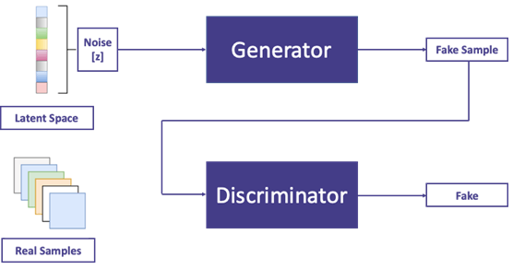

Slide 3
Generator (G):
The generator takes random noise (usually sampled from a Gaussian distribution) as input and generates samples (e.g., images) from this noise.
Initially, the generator produces random noise that doesn't resemble the true data distribution.
As training progresses, the generator learns to generate increasingly realistic samples by adjusting its parameters.
Discriminator (D):
The discriminator receives samples from both the real data distribution (e.g., real images) and the generator (fake samples).
Its task is to distinguish between real and fake samples.
Like the generator, the discriminator's parameters are adjusted during training to improve its ability to differentiate between real and fake samples.

Slide 4
Initialization:
The generator and discriminator are initialized with random weights.
Training Loop:
In each iteration of the training loop:
The generator generates a batch of fake samples by feeding random noise into the generator network.
The discriminator is fed with a batch consisting of both real samples from the dataset and the fake samples generated by the generator. It then predicts whether each sample is real or fake.
The discriminator's parameters are updated to improve its ability to distinguish between real and fake samples. This is done by minimizing a binary cross-entropy loss function, where the discriminator aims to correctly classify real samples as real (with a label of 1) and fake samples as fake (with a label of 0).
The generator's parameters are updated to produce more realistic samples that are more likely to fool the discriminator. This is done by maximizing the discriminator's error for fake samples, effectively pushing the generator to generate samples that are indistinguishable from real samples.
3.Convergence:
The training process continues iteratively until either a specified number of iterations is reached or until the generator generates samples that are indistinguishable from real samples according to the discriminator (i.e., when the discriminator's error for fake samples converges to a minimum).
Ideally, the equilibrium point reached is when the generator produces samples that are statistically indistinguishable from real data, and the discriminator is unable to differentiate between real and fake samples.

